Slide 1
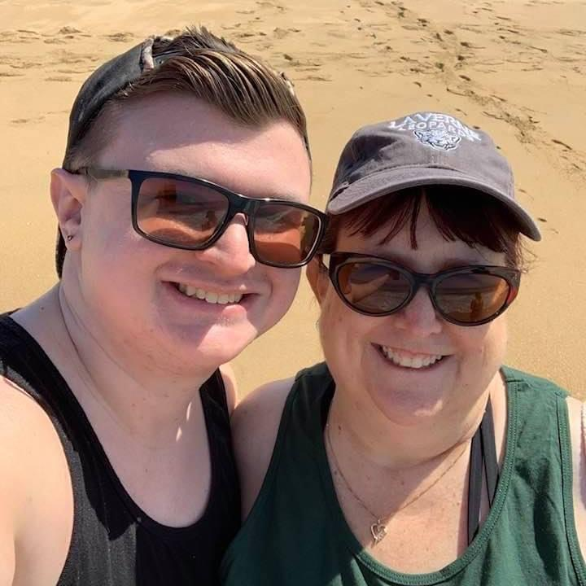
Mrs. McKellip
I have been teaching for
29 Years. This is my 13th year at Briggs. I have taught Kindergarten through Fourth Grade. I’m looking forward to a wonderful Year. #Bettertogether
Phone:(909)628-6497
Email:Laurie_McKellip@chino.k12.ca.us
Apps: Remind
Text 81010
Message: @mckellip21
Food: Flautas
Drink: Iced tea
Snack: popcorn
Restaurant: Tropical
Store: Target
Flower: Rose
Color: Coral
Hobby: crafts
Birthday!: 2/14

